Slide 1
Color Reactions of Proteins and Amino acids

Slide 2
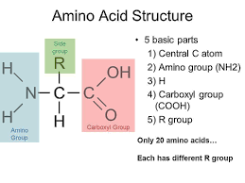
Amino acids and proteins
Amino acids are building blocks of all proteins, and are linked in series by peptide bond (-CONH-) to form the primary structure of a protein. Amino acids possess an amine group, a carboxylic acid group and a varying side chain that differs between different amino acids. There are 20 naturally occurring amino acids, which vary from one another with respect to their side chains.

Slide 3
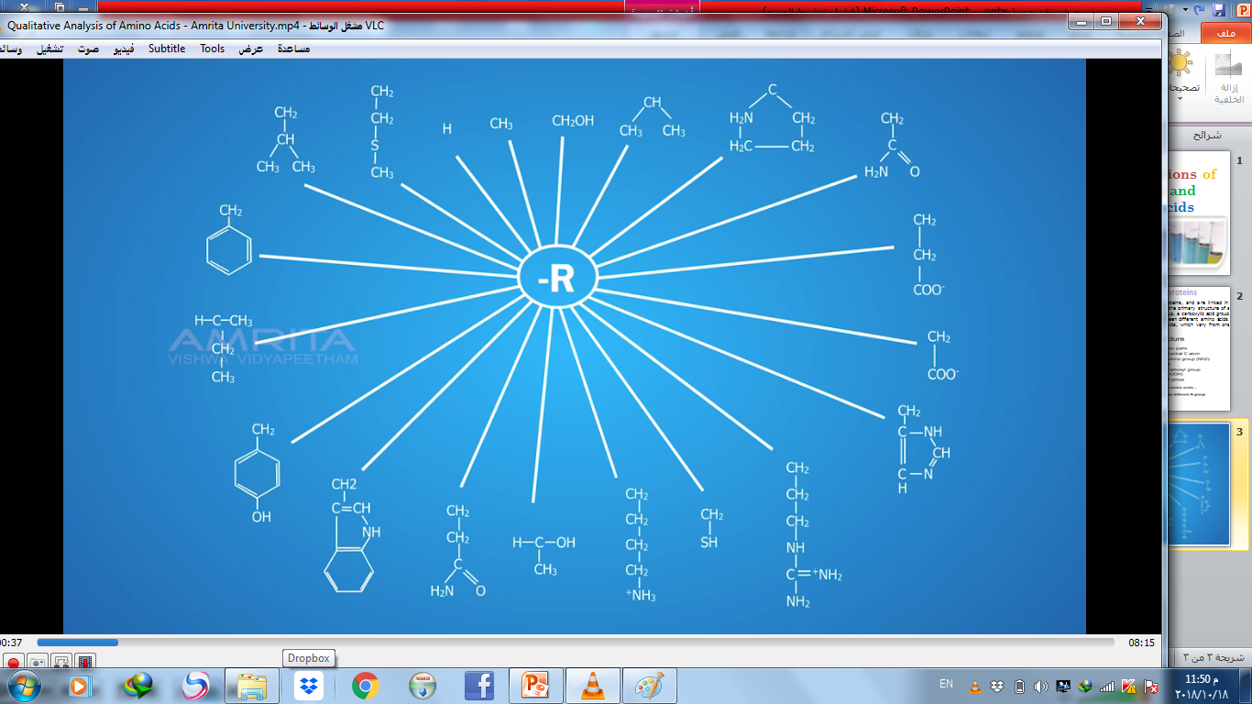

Slide 4
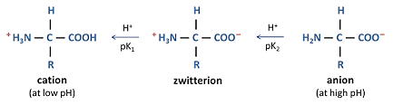
Amino acids and proteins
At a certain pH known as the isoelectric point an amino acid has no overall charge, since the number of protonated ammonium groups (positive charges) and deprotonated carboxylate groups (negative charges) are equal. Since the amino acids at their isoelectric points have both negative and positive charges, they are known as zwitterions.
Also amino acid are Amphoteric Compounds which mean they can act as acids and bases, due to presence of carboxyl group COOH that able to donate proton(H+), and convert to COO - and presence of amino group NH2 which is enable to accept this proton(H+) and convert into NH3+
Amino acids are critical to life. They have particularly important functions like being the intermediates in metabolism.
Amino acids are generally classified by the properties of their side chain into four groups. The side chain can make an amino acid a weak acid or a weak base, and a hydrophile if the side chain is polar or a hydrophobe if it is nonpolar.

Slide 5
